Slide 1
Java 8
Pregatit de: Alexandru Dima Data: 20.10.2014

Slide 2
Topics - Streams - Common Stream Operations - Primitive Streams - Collectors

Slide 3
Collections
Nearly every Java applications makes and processes collections
However processing collections is far from perfect:
– SQL like operations?
– How to efficiently process large collections?

Slide 4
So what’s a Stream?
Informally: A fancy iterator with database-like Operations
More formally: A sequence of elements from a source that supports aggregate operations.
Sequence of elements: a stream provides an interface to a sequenced set of values of a specific element type. A stream gets/computes elements on demand. It never stores the elements.
You can turn a collection into a Stream by calling the method .stream()
Stream<Integer> stream = numbers.stream();
Stream<String> stream = Stream.of(“test”,”test1,”test2”);

Slide 5
So what’s a Stream?
Source: Streams consume from a dataproviding source such as Collections, Arrays, or IO resources.
Aggregate operations: Streams support database-like operations and common operations from functional programing languages such as filter, map, reduce, find, match, sorted etc.
Pipelining: Many stream operations return a stream themselves. This allows operations to be chained and form a larger pipeline as well as certain optimisations (more later).
Internal iteration: In contrast to collections, that are iterated explicitly (“external iteration”), stream operations do the iteration behind the scene for you.

Slide 6
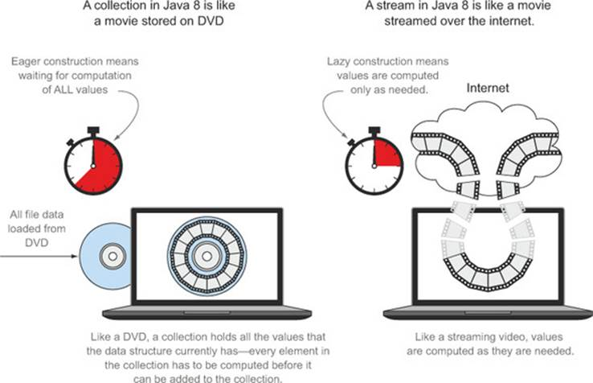
Streams vs Collections

Slide 7
Eager vs Lazy
Eager evaluation: evaluate first operation and start the next one only when completed
Lazy evaluation: evaluate only when we actually need to iterate the result of an operation
Intermediate operations are lazy because it enables optimizations
- a pipeline of three operations could be merged to one

Slide 8
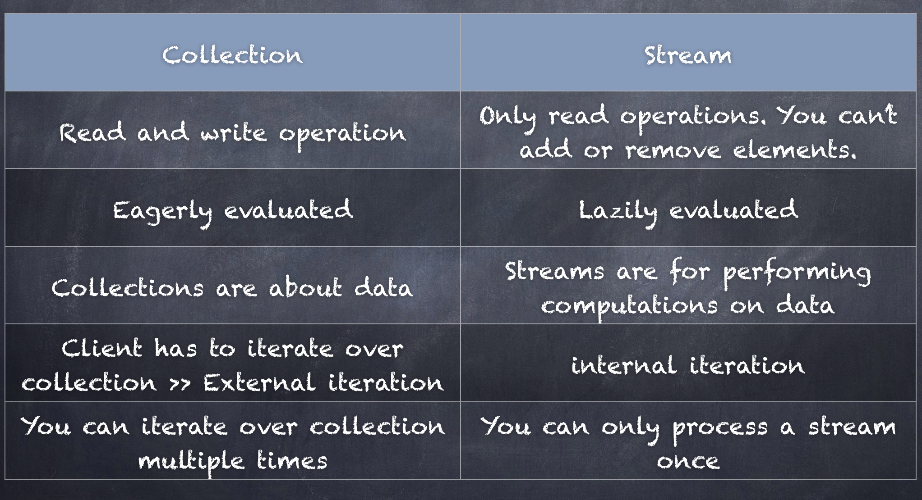
Streams vs Collections

Slide 9
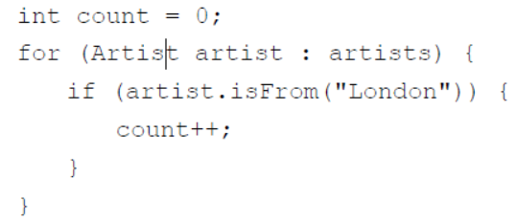
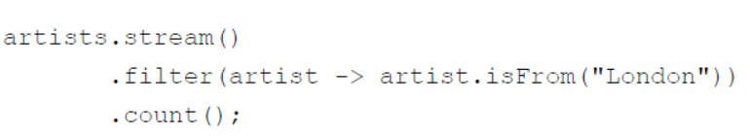
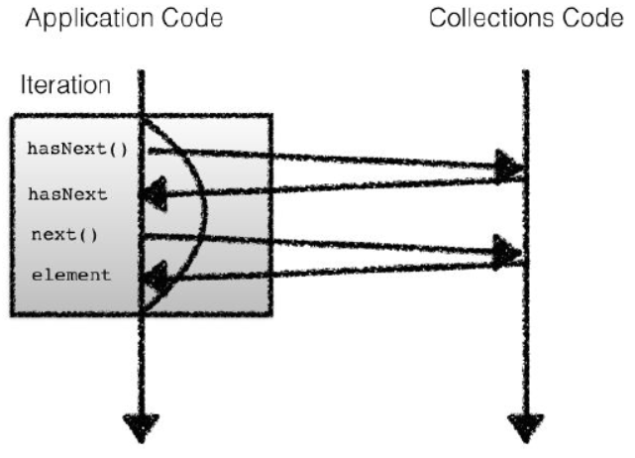
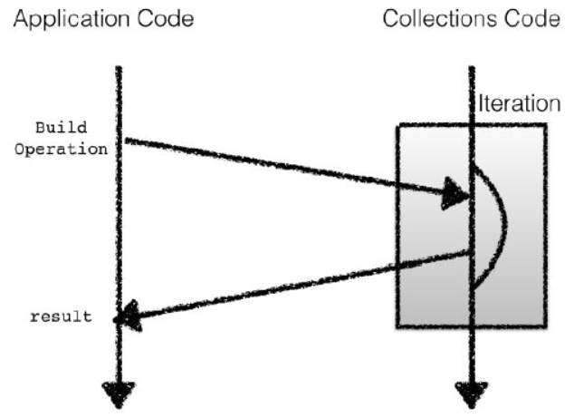
Internal and External Iteration

Slide 10
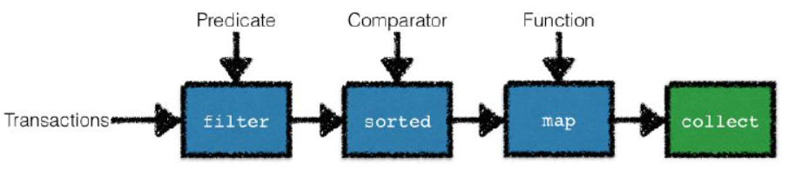
Pipelining

Slide 11
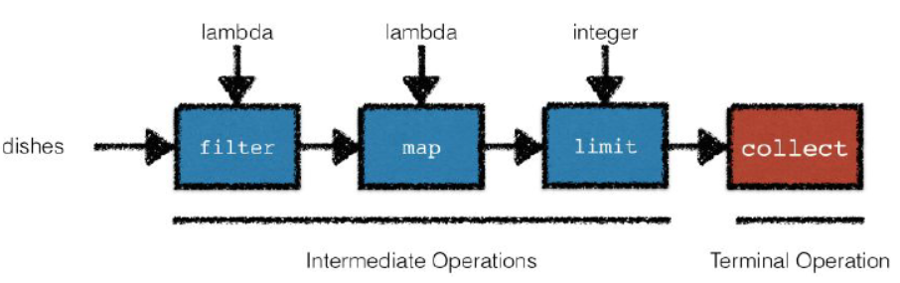
Two types of operations
intermediate: return a Stream and can be “connected”
terminal: return a non-Stream value (e.g. int, String,…)

Slide 12
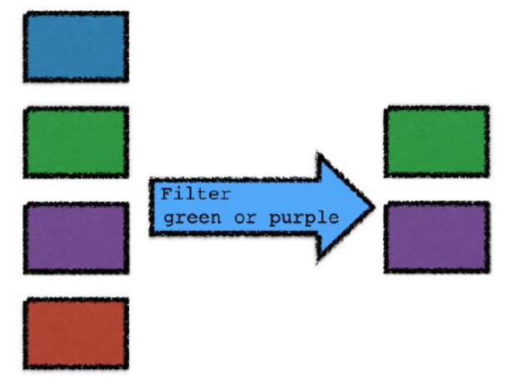
Common Stream Operations
Filters:
import static java.lang.Character.isDigit;
List<String> beginningWithNumbers =
Stream.of("a", "1abc", "abc1")
.filter(value -> isDigit(value.charAt(0)))
.collect(Collectors.toList());
assertEquals(
asList("1abc"),
beginningWithNumbers);

Slide 13
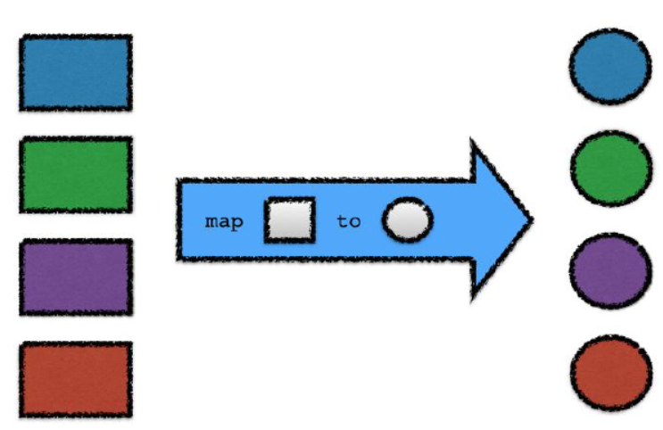
Common Stream Operations
Map
- allows us to apply a function hat takes in a parameter of one type, and returns something else
import static java.util.stream.Collectors.toList;
List<String> collected = Stream.of("a", "b", "hello")
.map(value -> value.toUpperCase())
.collect(toList());
assertEquals(
asList("A", "B", "HELLO"),
collected);

Slide 14
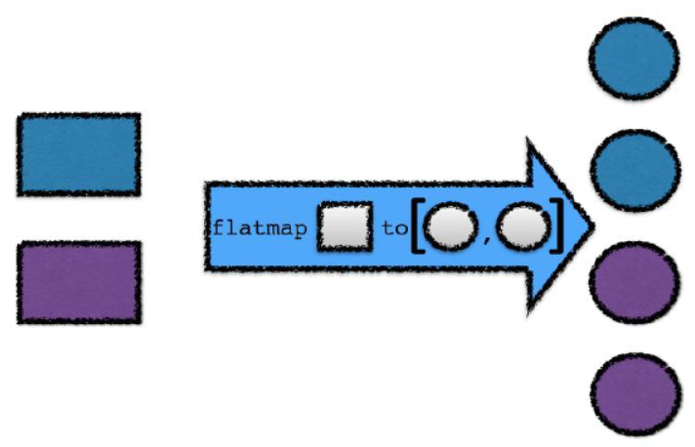
Common Stream Operations
flatMap
lets you replace a value with a Stream and
concatenates all the streams together
// The Album class has a method:
// List<Track> getTracks()
List<Album> albums = loadAlbums()
albums.stream()
.flatMap(album -> album.getTracks().stream())
.collect(toList())

Slide 15
Workshop:

Slide 16
Checking a predicate matches all/no elements
boolean isHealthy =
menu.stream().allMatch(d -> d.getCalories() < 1000);
boolean isReallyBad =
menu.stream().noneMatch(d -> d.getCalories() < 1000);
boolean isAnythingHealthy =
menu.stream().anyMatch(d -> d.getCalories() < 1000);

Slide 17
Finding an element
Optional<Dish> dish =
menu.stream().filter(Dish::isVegetarian).findAny();
Optional<Dish> dish =
menu.stream().filter(Dish::isVegetarian).findFirst();

Slide 18
The Reduce Pattern
The reduce pattern takes a stream of values and produces a single value at the end.
Object accumulator = initialValue;
for(Object element : collection) {
accumulator += element;
}
return accumulator;

Slide 19
Summing: an example of reduce
int sum =
Stream.of(4, 5, 3, 9).reduce(0, (acc, x) -> acc + x);
assertEquals(21, sum);

Slide 20
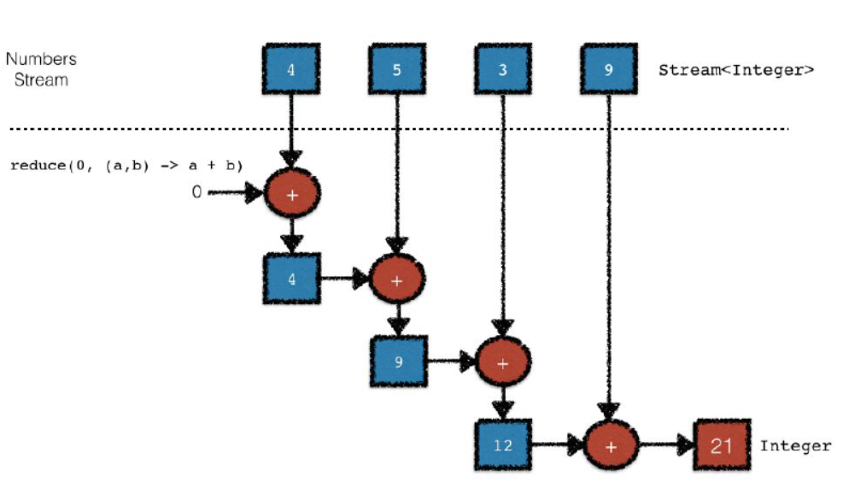

Slide 21
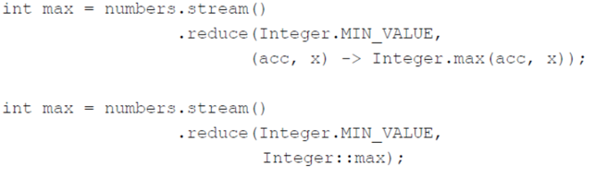
Reduce more examples

Slide 22
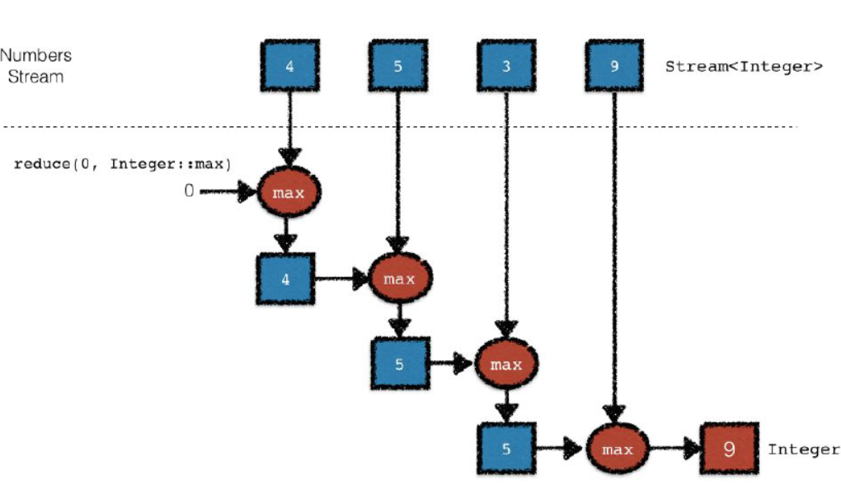
Reduce:max

Slide 23
One Argument Reduce
Optional<Integer> sum = Stream.of(1, 2, 3, 4).reduce((acc, x) -> acc + x);
assertEquals(10, sum.get());

Slide 24
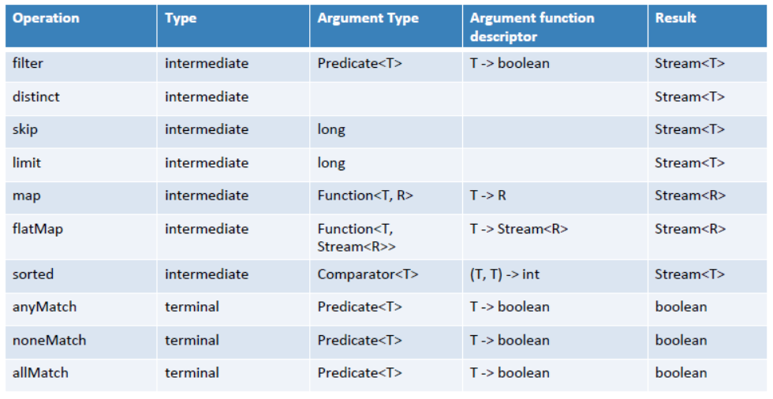
Summary of operations

Slide 25
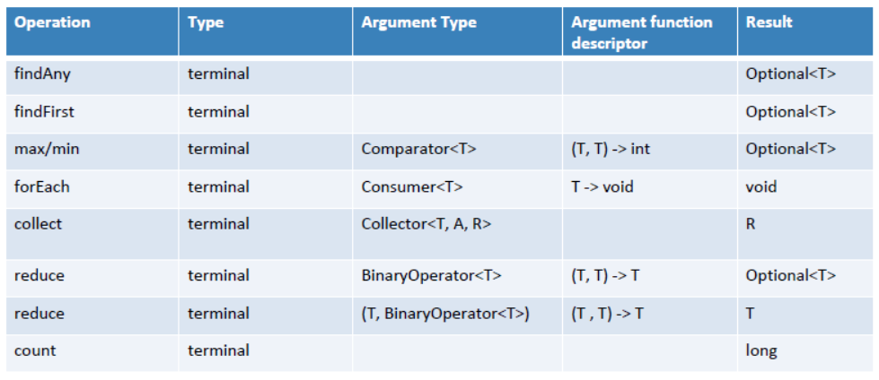
Summary of operations

Slide 26
Primitive Streams
int calories = menu.stream()
.map(Dish::getCalories)
.sum();
This isn’t possible !!!
• Stream<T>: T would need to be summable!
• Streams API bring primitive specializations to fix this problem

Slide 27
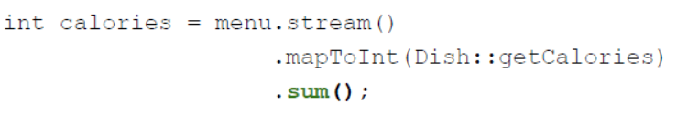
Primitive Streams
• IntStream, LongStream, DoubleStream specialize the elements for int, long and double (more efficient as no boxing!)
• Can convert a normal stream to a primitive streams using mapToInt, mapToLong or mapToDouble

Slide 28
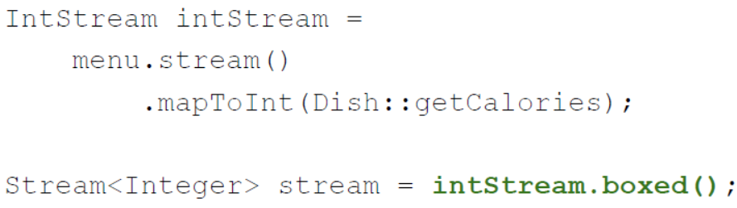
Primitive streams to normal Stream
• use boxed()

Slide 29
Building Streams
You’ve seen how to create a stream from a collection
You can also create streams from
– Values
– Arrays
– File
– Function: infinite streams!

Slide 30
Building streams - values
• Stream.of
Stream<String> stream = Stream.of("Java", "8", "Training");
stream.map(String::toUpperCase)
.forEach(System.out::println);
• Empty stream:
Stream<String> emptyStream = Stream.empty();

Slide 31
Building streams - arrays
int[] numbers = {2, 3, 5, 7, 11, 13};
int sum = Arrays.stream(numbers).sum();

Slide 32
Building streams - file
long uniqueWords =
Files.lines(Paths.get("data.txt"), Charset.defaultCharset())
.flatMap(line -> Arrays.stream(line.split(" ")))
.distinct()
.count();

Slide 33
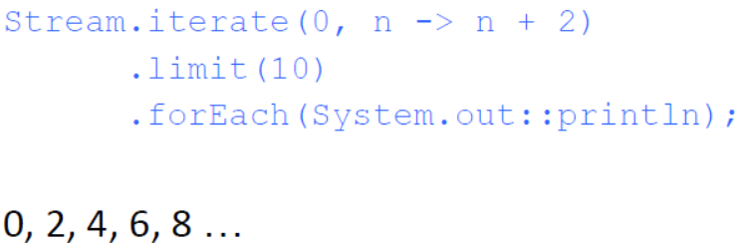
Infinite streams
A stream that doesn’t have a fixed size like when we create a stream from a fixed collection.
Streams produced by iterate and generate create values on demand given a function and can therefore calculate values forever!
• Takes a starting value and a lambda of type
UnaryOperator<T>
• Applies the lambda successively to the result
The limit allows us to turn an infinite stream into a finite sized stream

Slide 34
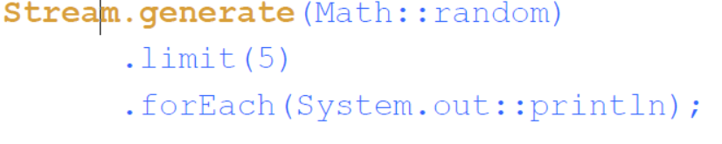
Infinite streams
Generate
- Lets you produce an infinite stream of values computed on demand

Slide 35
Workshop:

Slide 36
Collectors
Most terminal operations that you’ve seen so far were returning a single value E.g. boolean, int
collect(toList()) was returning a List
collect takes a recipe to accumulate the elements of a stream into a container
This recipe is a Collector object and is the parameter passed to the method collect

Slide 37
Collect vs. Reduce
Reduce is an immutable reduction
○ combine values and produce a new value
Collect is a mutable reduction
○ accumulates elements into a container
○ Collectors let you abstract and re-use reduction strategies

Slide 38
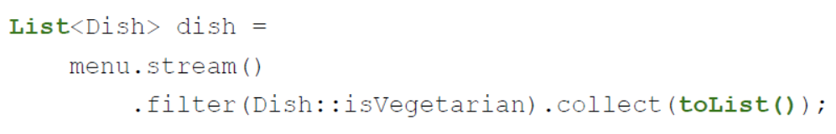
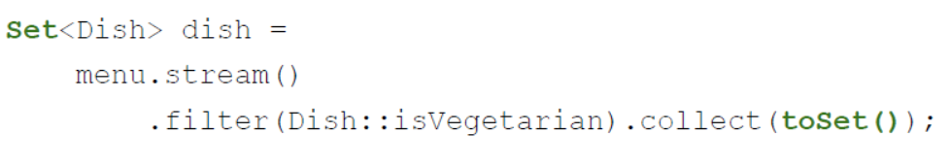
Collecting to lists and sets
You’ve seen toList() already:
You can also use toSet():

Slide 39
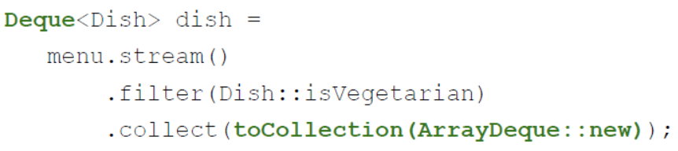
Flexible collection
You can use toCollection(supplier) for more flexibility

Slide 40
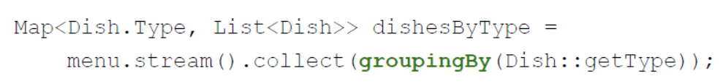
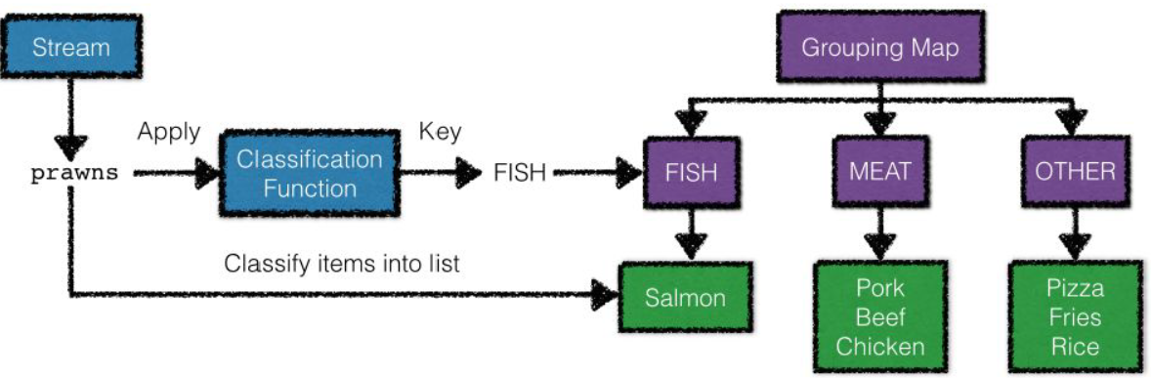
Grouping
"GROUP BY" operation inspired from SQL
Groups Stream elements according to a classification function, and returns the results in a Map.

Slide 41
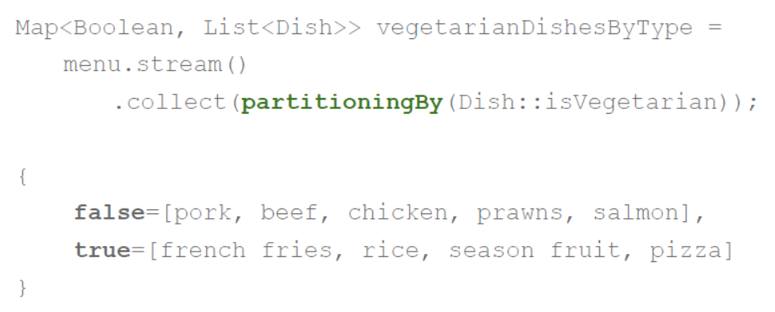
Partitioning
Special case of grouping, which takes a partitioning function
A partitioning function is a Predicate (a function that returns a boolean)

Slide 42
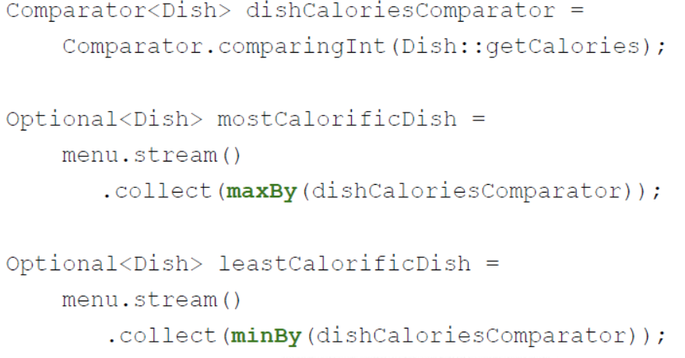
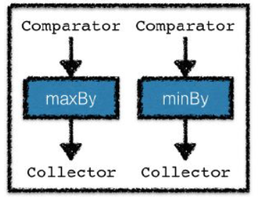
Maximum and minimum

Slide 43
Counting
long howManyDishes = menu.stream().collect(counting());
long howManyDishes = menu.stream().count();
The counting Collector can be useful especially when used in combination with other Collectors

Slide 44
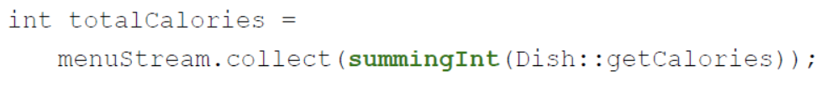
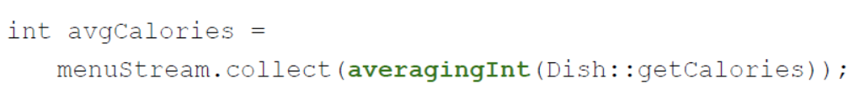
Sum and Average
Sum the values of using an extraction function which returns a number. (summingInt, summingLong, summingDouble)
Calculate the average value using an extraction function which returns a number. (averagingInt, averagingLong, averagingDouble)

Slide 45
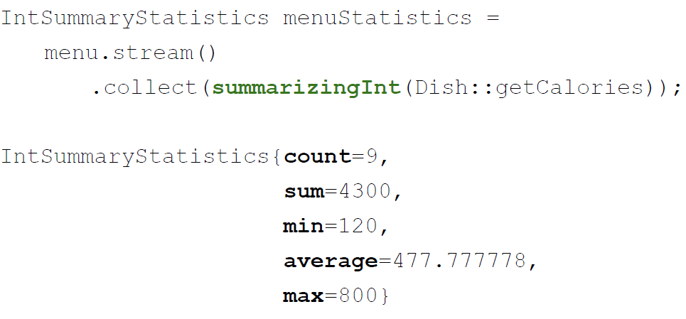
Summary statistics
Returns summary statistics in a single operation using an extraction function that returns a number
summarizingInt, summarizingLong, summarizingDouble

Slide 46
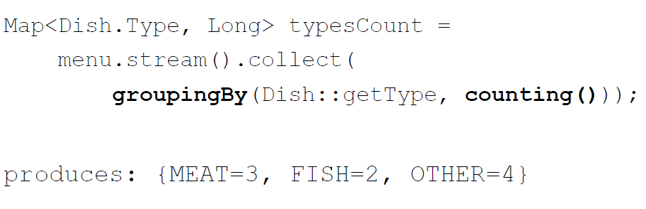
Composing collectors
The collectors groupingBy and partitioningBy accept other collectors as argument to create more complex queries.

Slide 47
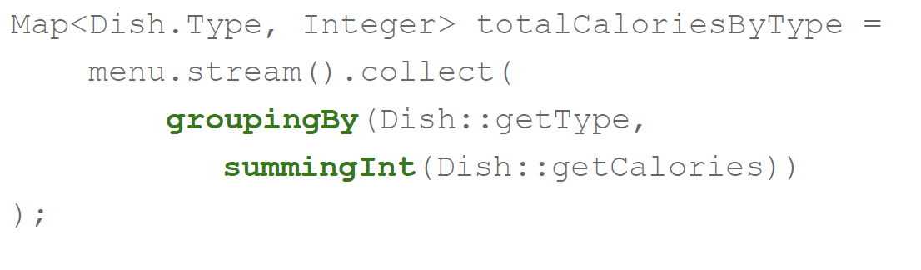
Composing collectors

Slide 48
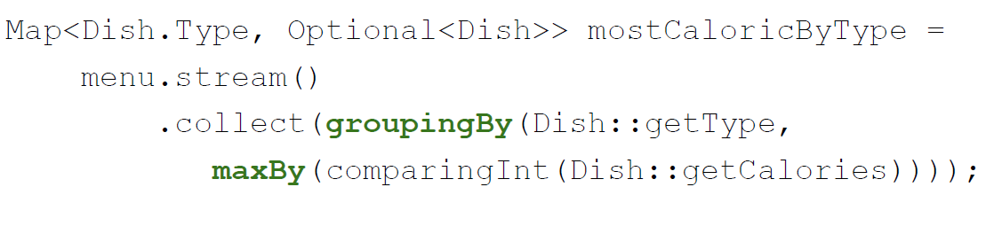
Composing collectors

Slide 49
Workshop:

Slide 50
Questions?

Slide 51
Thank you!

